Slide 1
GOVT. COLLEGE , ROPAR
Department of Economics
Topic: Theory of production
Introduction of production function
Types of production function
Fixed and variable inputs or factors of production
Time period
Variation of output or product in short run
LAW OF PRODUCTION
CONDITIONS OF APPLICABILITY
RETURE TO A FACTOR
WHAT IS LAW OF DIMINISHING RETURN?
PROF. RITU CLASS B.A SEM 1

Slide 2
Introduction of production function
Production function refers to the technical relationship between the quantity of good produced (Output) and the factors of production(input) necessary to produce it .
Production function can be expressed with the following equation:
Y=f(L,K,S)

Slide 3
Definition
According to Waston , “The relation between a firm’s physical production (output)and the material factor of production (input) is referred to as production function .”

Slide 4
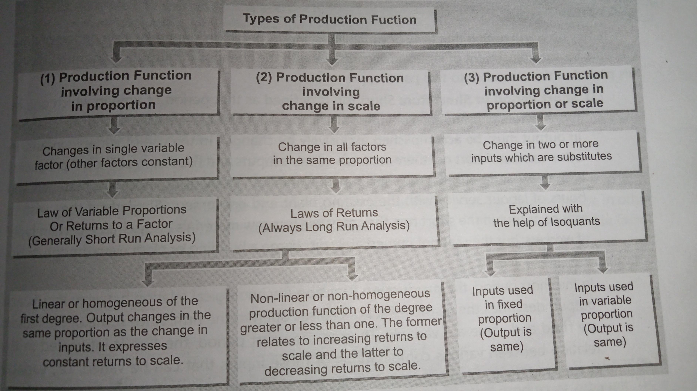
Types of production function

Slide 5
Fixed and variable inputs or factors of production
Fixed input or factors of production: it is defined as one, the quantity of which cannot be changed in the short run as level of output changes .
Variable input or factor of production : it is defined as one the quantity of which may be changed in the Short run es the level of output changes

Slide 6
Time period
Short period or short run : short run is defined as that period of time inwhixh one or more factors of production or inputs are fixed and other are variable
Long period or Long run : Long period or long run is defined as that period of time on which all factors of production or inputs are variable. In the long run all factors are varied in quantity and there are no fixed factors.In other word, long period refer to that period of time in which the quantity of all factors can be increased or decreased.Thus, there is no distinction between fixed and variable factors in the long run, as all factors become variable factors

Slide 7
Variation of output or product in short run
Total Product (TP): Total product of a variable factor is maximum output produced by combining a given input of that factor with fixed factor
Average Product (AP): The average product of a variable factor is simply the total product od the factor divided by the total units of the variable factor it measure the average output

Slide 8
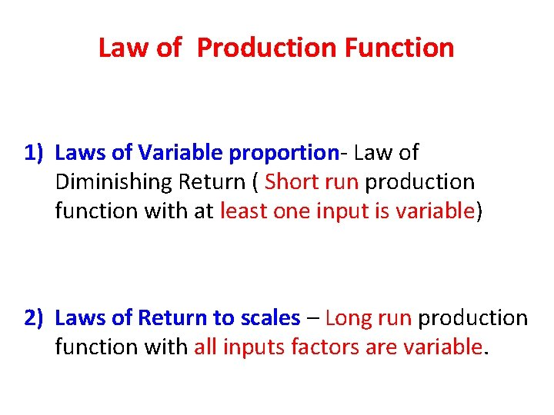
LAW OF PRODUCTION-:Laws of Production in economics deals with the concepts of cost and producers equilibrium. It is an important aspect of economics as it helps a business determine the level of output that leads to maximum profits. It also defines the various variable and fixed costs of the firm.

Slide 9
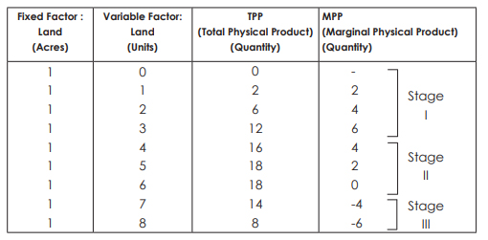
LAW OF VARIAALE PERPOTION-:Laws of Production in economics deals with the concepts of cost and producers equilibrium. It is an important aspect of economics as it helps a business determine the level of output that leads to maximum profits. It also defines the various variable and fixed costs of the firm.

Slide 10
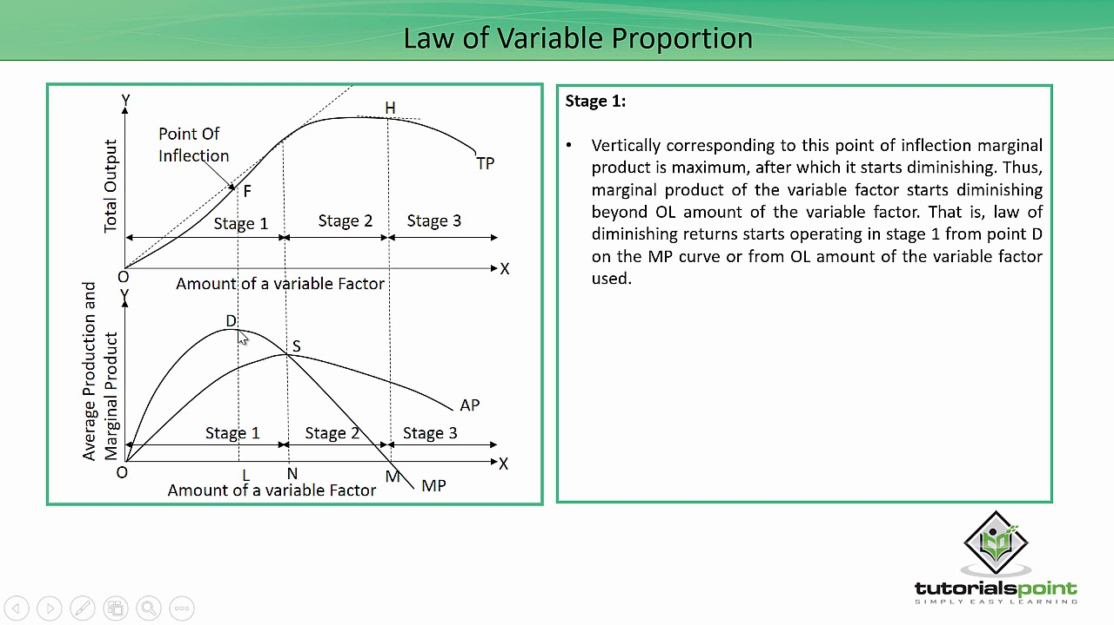
A

Slide 11
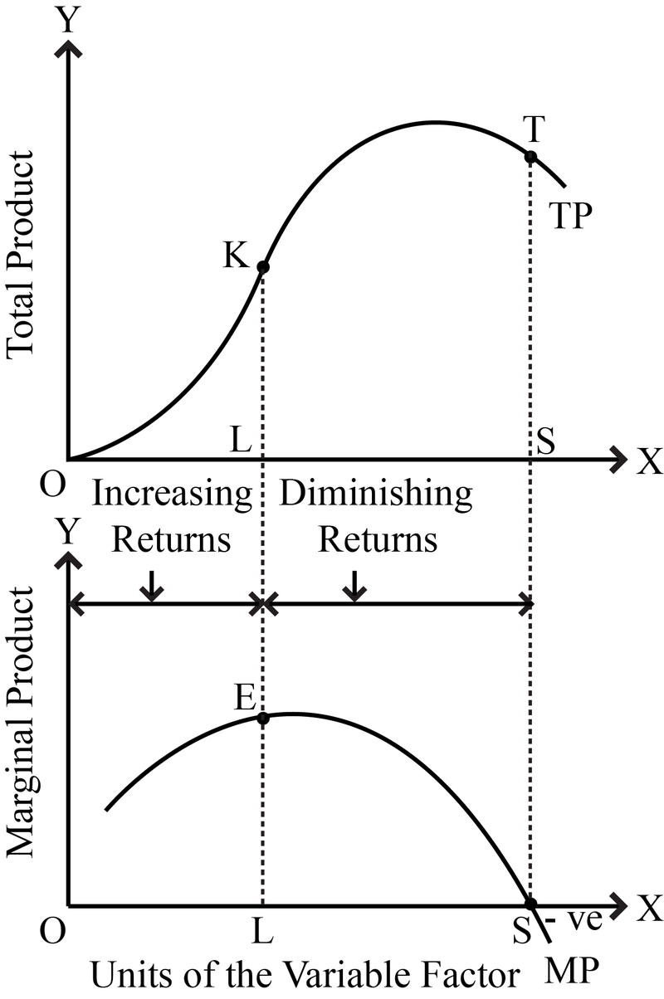
A SIMPLIFIED VERSION OF THE STAGES OF PRODUCTION -:

Slide 12
CONDITIONS OF APPLICABILITY
INDIVISIBILITY OF FACTORS-: The main cause of the stage of increasing returns is that some factors of production are indivisible . It also tends to improve the degree of co-ordination between the fixed and variable factors.
CHANGE IN FACTORE RATIO-: The main cause of the operation of the factors of production is variable while others are fixed. When this variable factors is used with fixed factors, then their ratio compared to variable factors falls. Production is the result of the cooperation of all factors.

Slide 13
RETURE TO A FACTOR-:
Returns to a factor relates to the behaviour of total output as one variable input, say labour, is varied. It is a short-run concept. There are three aspects of returns to a factor:
(i) Increasing Returns to a Factor
(ii) Constant Returns to a Factor, and
(iii) Diminishing Returns to a Factor.

Slide 14
WHAT IS LAW OF DIMINISHING RETURN?
The law of diminishing returns is an economic principle stating that as investment in a particular area increases, the rate of profit from that investment, after a certain point, cannot continue to increase if other variables remain at a constant. As investment continues past that point, the return diminishes progressively.
For example, the law of diminishing returns states that in a production process, adding more workers might initially increase output and eventually creates the optimal output per worker. After that optimal point, however, the efficiency of each worker decreases because other factors -- such as the production technique or the available resources -- remain the same (this is known, more specifically, as the law of diminishing marginal returns). This kind of problem might be addressed by modernizing the production technique using technology.

Slide 15
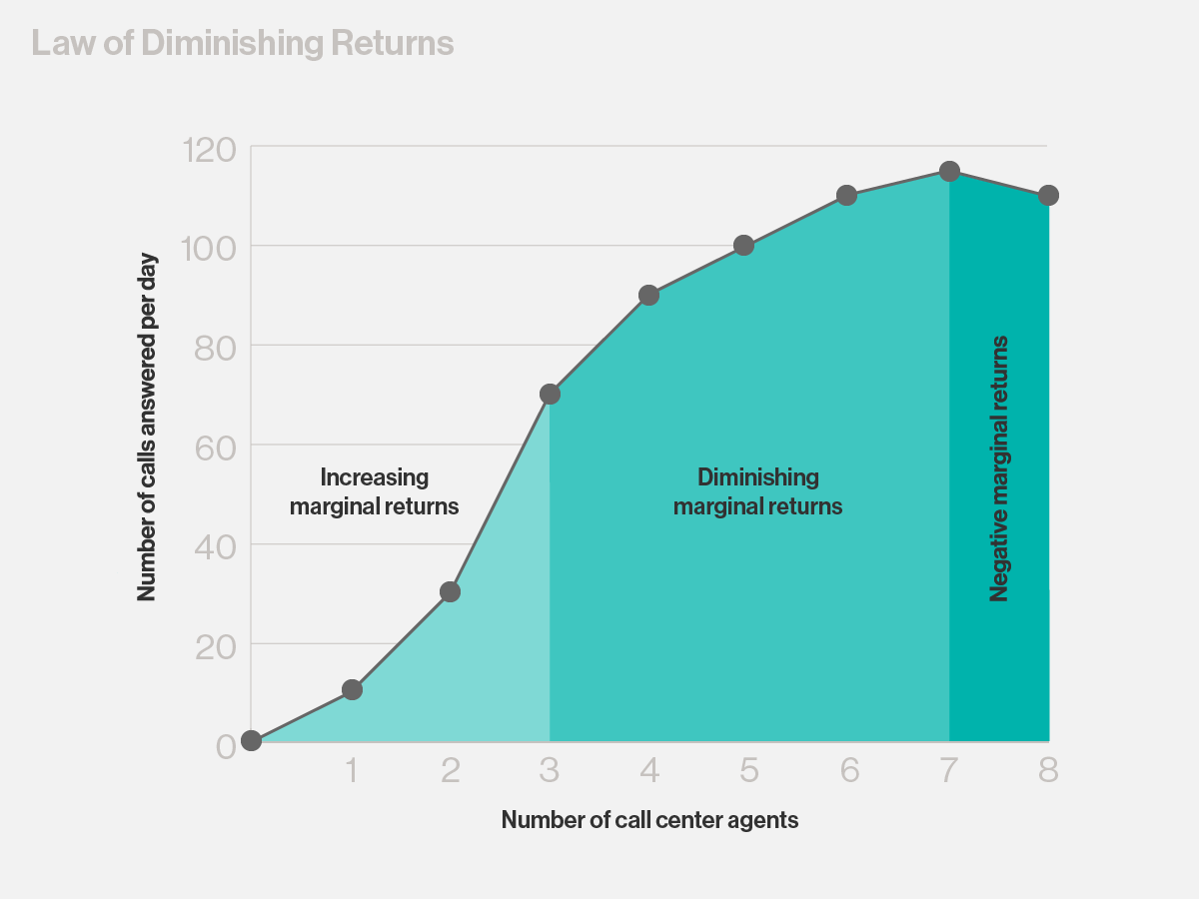
A

Slide 16
THANK YOU
A

